Slide 1
Module A
Unit A3
Vocabulary
Language Functions
Speaking Activities
UTN FRVM Lic. Evangelina Cecchel - Lic. Bibiana Fernandez

Slide 2
Vocabulary:
Travel
Accommodation
Adverbs
UTN FRVM Lic. Evangelina Cecchel - Lic. Bibiana Fernandez

Slide 3
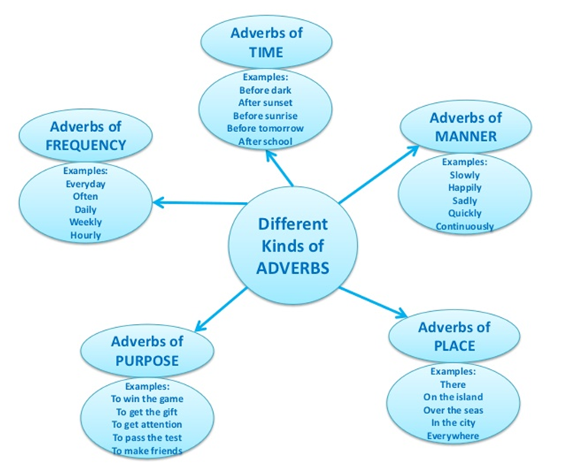
UTN FRVM Lic. Evangelina Cecchel - Lic. Bibiana Fernandez

Slide 4
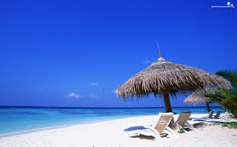
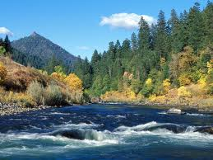
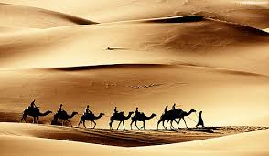
Where would you like to go?
Why?
ocean
beach
mountain
desert
forest
river
UTN FRVM Lic. Evangelina Cecchel - Lic. Bibiana Fernandez

Slide 5
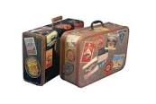
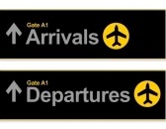
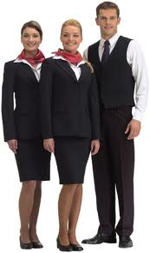
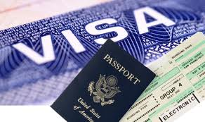
Luggage
Baggage claim area
Depart or leave
Arrive
On time /delayed
Flight attendants
documents
UTN – FRVM Lic. Evangelina Cecchel – Lic. Bibiana Fernandez

Slide 6
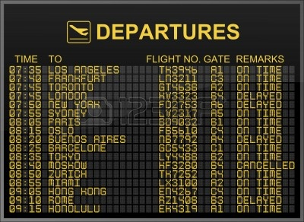
Look at the display screen. Ask for / give information about flight departures.
UTN FRVM Lic. Evangelina Cecchel - Lic. Bibiana Fernandez

Slide 7
I’m looking for….
an apartment a house
to rent to lease
furnished convenient
With…
utilities included a nice view
UTN FRVM Lic. Evangelina Cecchel - Lic. Bibiana Fernandez

Slide 8

Look at the advertisement. Ask for /give information about the apartment.
UTN FRVM Lic. Evangelina Cecchel - Lic. Bibiana Fernandez

